Slide 1
System Security Enhancements in Windows 10
Samuel Aspiranti
INF Directed Research
Summer 2017

Slide 2
Introduction
Focus is on Virtualization Based Security (VBS) Features
Required hardware and technologies to make VBS work and protect the system from subversion
Starting with boot process and loading of operating system / prerequisites
Discussing several layers of protection from hardware to applications

Slide 3
BIOS
Has been around since 1974
Basic instructions stored in memory on board
Tells the computer what to do when powered on
Where firmware and device drivers are initialized
Executes before the operating system is loaded
IDE/ATA inteface 28bit addressing limited allowable drive size
Forced extensible BIOS, eventual creation of Extensible Firmware Interface (EFI) then Unified Extensible Firmware Interface (UEFI)

Slide 4
UEFI
Modern replacement of BIOS created by intel and agreed upon by the industry
Can run in 32 bit or 64 bit
More addressable memory space, faster load times
Uses GPT Partitioning instead of Master Boot Record
Globally Unique Identifier for partition tables allows for more partitions
MBR store boot data and partitions in the same place – easy to corrupt
Enables GUI environment rather than primitive menus
Supports additional features – notably Secure Boot

Slide 5
Secure Boot
MBR relied on the system knowing where the instructions to load the operating system were located – Windows boot loader
No integrity checks, boot anything it finds, attacker can easily trick the system into booting a different OS or worse – rootkit malware
User may have no indication that their system is compromised
Secure Boot checks the Windows boot loader for a signature
Signature indicates that the boot loader has not been replaced with untrusted code. Will not load code that is not signed by Microsoft.
Requires Microsoft certificates to be loaded on the machine
Usually done by system OEMs, at time of manufacture

Slide 6
Trusted Platform Module
Piece of hardware dedicated to holding secret keys and performing cryptographic operations
Generating keys, attestation, hashing, encryption, decryption, etc.
Should have physical tamper resistant protections
During boot, the TPM inspects the windows boot loader code by validating the code signature
Secret keys never leave the device, all operations happen within the TPM itself

Slide 7
Why Does This Matter?
Assurance is all about providing evidence that a system does what it is intended to do – and nothing more
If we do not begin with a secure state, we can not prove that a change in system state will result in a secure state
If a system is compromised at a low level (hardware, boot loading) any security features at a higher level may be irrelevant
If I “own” the hardware and boot loader, I can own the kernel, OS, applications, and so on
These are prerequisite to enabling Virtualization Based Security

Slide 8
Microsoft Aiding Assurance
Microsoft is seeing the importance of security and doing something about it
Compartmentalization of code into trusted modules
Creating segmented environments to isolate exploits
Leveraging virtualization for security features

Slide 9
Input Output Memory Management Unit
Blocks direct memory access by hardware
Hypervisor can isolate environments using memory allocation, but hardware bus could leak sensitive information (more on this later)
Intel VT-d: Intel Virtualization Technology for Directed I/O
Available on most Intel CPUs since Core 2 Duo
AMD-V: AMD’s version
Available on most AMD CPUs since AMD A series

Slide 10
AppLocker
Introduced in Windows 7
Allows administrators to create rules for what applications are allowed to run on any system
Rules can white or blacklist applications based on:
File extension
Digital Signature – signed by
Hash if not digitally signed
Can prevent regular users from loading malicious software
Runs in Local Security Policy – vulnerable to being disabled if attacker has administrative privileges

Slide 11
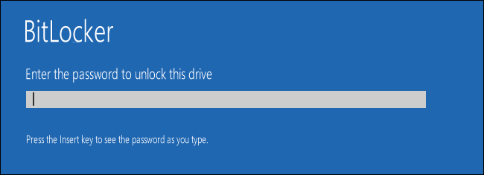
BitLocker
Introduced with Windows Vista
Used mainly for full disk encryption
Relies on Trusted Platform Module to store keys and perform cryptographic operations
Can be used with a PIN and/or USB drive as key to start process of unlocking an encrypted disk

Slide 12
Virtualization Based Security
Much like using separate Virtual Machines for different services
If one VM is compromised, not all services are compromised
Using virtualization on a single system to:
Create isolated environments to protect critical processes/memory from tampering
Reduce attack surface to lower layers
OS / Kernel are no longer the target, the hypervisor is
Requires Hypervisor supported CPU / Hyper-V
Handles management of memory and enforces the isolation

Slide 13
Virtualization Based Security
Virtual Trust Levels Assigned By Hypervisor
VTL 0, Normal World
VTL 1, Secure World
(higher number being more restricted)
Trusted processes, known as Trustlets, run in the secure kernel
LSAISO – Credential Guard
BIOISO – Biometrics Information
vTPM – Virtual TPM
HVCI – Hypervisor Code Integrity Verification
Aimed at protecting from kernel based malware

Slide 14
User Mode vs Kernel Mode
Normal World VTL-0
Kernel Mode
User Mode
Kernel Mode
User Mode
Secure World VTL-1
HyperVisor

Slide 15
Second Level Address Translation
Feature of a CPU – hardware support required
Intel: extended page table, AMD: Rapid Virtualization Indexing
Hyper-V will not work without it
Cache on CPU stores a memory address table
On CPU = better performance
Normal systems us virtual and physical memory addresses
Running processes use virtual addresses
CPU translates virtual address to physical address
Virtualized systems have an additional layer of abstraction

Slide 16
Second Level Address Translation

Slide 17
Virtual Secure Mode
Implementation of VBS to create that isolated environment
This environment has its own kernel mode or “secure kernel”
VTL-1
Secure Kernel much smaller than normal mode kernel
300kb vs 8MB
Concept of minimization being used
Smaller kernel is easier to verify and less likely to contain bugs
Hypervisor does this by creating to separate areas in memory
Virtual Trust Levels

Slide 18
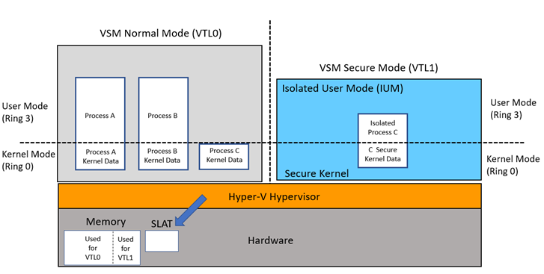
Isolated User Mode
User mode running in VTL-1
Even if the kernel is compromised on the guest OS, it can not access this memory space
Sits on top of secure kernel
This is where the Trustlets run

Slide 19
Credential Guard
Local Security Authority Subsystem Service (LSASS.exe)
Verifies users, creates access tokens
In normal user mode makes RPC call to LSAIso.exe
Secret Keys remain isolated in secure process, only encrypted credentials are passed to normal user mode.
This prevents attackers from stealing derived credentials
Is a Trustlet – Trusted process LSAIso.exe (Isolated LSA) resides in secure, isolated user mode memory space

Slide 20
Credential Guard

Slide 21
ProcDump of LSASS vs LSAISO

Slide 22
Device Guard
Configurable Code Integrity (CCI) - Think AppLocker improved
Allows only known good, trusted, signed code to run on the system
Kernel Mode Code Integrity
Prevent kernel from running unsigned drivers
Process running in VTL-1
Protected from leaking information through memory dumps
Even an Administrator could not stop the process
Packet Inspection Tool for Line of Business applications
For binaries that are “trusted” but not signed
Creates catalog of all allowed applications

Slide 23
Microsoft Edge Sandboxing
Aimed specifically at blocking remote code execution attacks
Where a vulnerability in a web browser or plugin allows an attacker to run their own code on the target system
Blocks drivers that edge doesn’t need
Only Microsoft signed drivers are given access
Windows Defender Application Guard
Leads way to allow other applications to run in an isolated environment

Slide 24
Further Thoughts
Expanded use of virtualization and modularization to isolate applications, prevent exploits that will eventually come up from causing more damage
Use of Hypervisor and SLAT as reference monitor
Any call to hardware storage is already marshalled by the hypervisor
Access policy can be established at time of boot, guest OS never has a chance to bypass or change it – could be used for multi level clients
SLAT would prevent even administrators from accessing protected resources as long as the host virtual memory page table stores access permissions

Slide 25
Resources and References
Mitigating Credential Theft using the Windows 10 Isolated User Mode https://channel9.msdn.com/Blogs/Seth-Juarez/Mitigating-Credential-Theft-using-the-Windows-10-Isolated-User-Mode
Isolated User Mode in Windows 10 https://channel9.msdn.com/Blogs/Seth-Juarez/Isolated-User-Mode-in-Windows-10-with-Dave-Probert
Learn about Windows 10 Secure Kernel https://channel9.msdn.com/events/Ignite/2016/BRK4010?term=secure
Device Guard in Windows 10 http://www.kraftkennedy.com/device-guard-windows-10/
Secure Boot Overview https://technet.microsoft.com/en-us/library/hh824987.aspx
Windows 10 Device Guard and Credential Guard Demystified https://blogs.technet.microsoft.com/ash/2016/03/02/windows-10-device-guard-and-credential-guard-demystified/
Isolated User Mode (IUM) Processes https://msdn.microsoft.com/en-us/library/windows/desktop/mt809132(v=vs.85).aspx
Virtualization Based Security - Part 1: The boot process http://blog.amossys.fr/virtualization-based-security-part1.html
Introduction to Device Guard https://docs.microsoft.com/en-us/windows/device-security/device-guard/introduction-to-device-guard-virtualization-based-security-and-code-integrity-policies
Strengthening the Microsoft Edge Sandbox https://blogs.windows.com/msedgedev/2017/03/23/strengthening-microsoft-edge-sandbox/

